Slide 1


Store Sales Analytics
17 Feb 2024
Guided By- Aditya Jain
~ 20DIT059 Malav Patel

Slide 2
Agenda
Introduction
Requirement Gathering
Target Audience
Tools and Technology
Ask a Question?

Slide 3
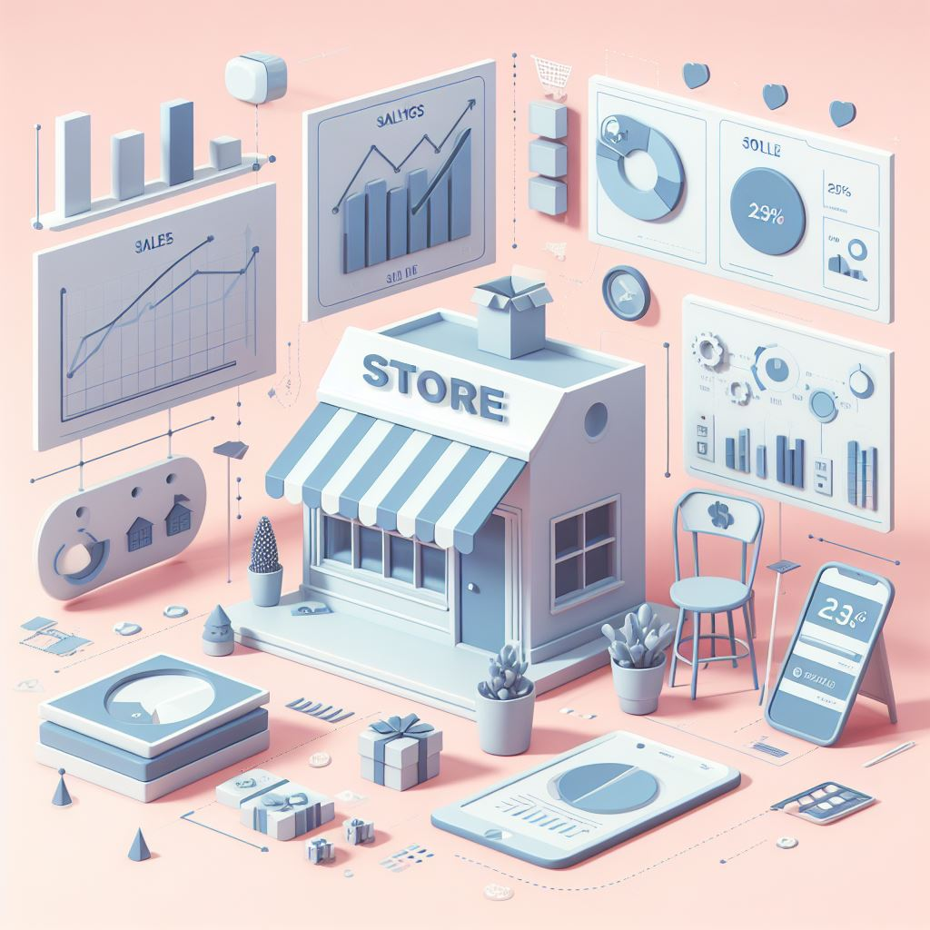
Introduction

Slide 4
Overview
Analysing sales data from retail stores to gain insights into performance and customer behaviour.
*What Type of gain insights? 🤨
Identify best-selling products.
Understand peak sales periods.
Objectives
Analyses historical sales data.
Identify trends and patterns.
Provide actionable insights for store management.
Create a user-friendly Power BI dashboard for the marketing team to easily interact with and gain insights.

Slide 5

Requirement Gathering

Slide 6
Observation Methodology
Utilized Google Meet to join client meetings remotely.
As an intern, observed client interactions without direct interaction, focusing on active listening and observation.
*What is Inventory? 🤨
the stock of materials that a business holds for the purpose of resale, production, or future use.
Identified Client Inventory Issues ⚠️
Noticed a trend where companies selling products online experience fluctuations in demand due to factors like product returns and unpredictable market demand.
Proposed leveraging Power BI dashboard to provide real-time insights into inventory levels, sales trends, and demand forecasting to optimize inventory management and meet customer demands efficiently.

Slide 7

Target Audience

Slide 8
Sales Team
Inventory Team
primary users of the eventual solution
Their input and requirements are crucial to ensure the solution meets their needs for sales data analysis and optimization of strategies.
Beneficiaries of Solution Insights
Involving the Inventory Team in the requirement gathering process ensures their challenges and requirements are addressed in the development of the solution.

Slide 9

Tools and Technology

Slide 10





Business understanding
communication
~ Technical Skills
~ Non-Technical Skills

Slide 11
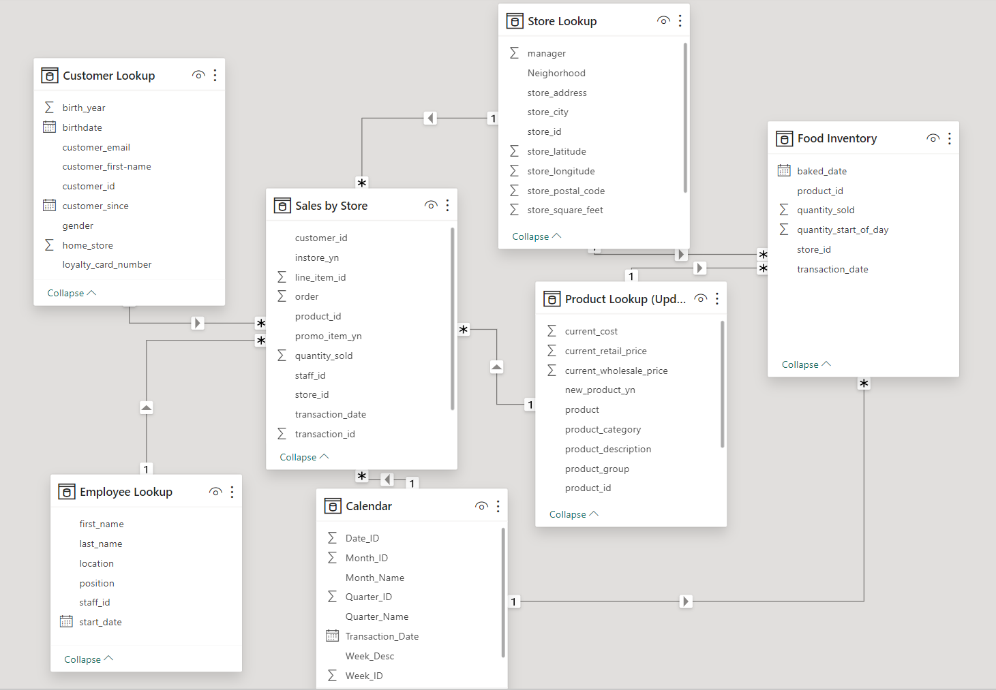

Slide 12

How do you think implementing real-time inventory tracking would impact your daily operations?
How do you anticipate your project will benefit the client's sales and inventory management processes?
How do you plan to measure the success of your project?
Can you discuss any potential challenges or risks that might affect the outcome of your project?
Is the UI (User Interface) of Power BI more important, or is any other factor crucial?

Slide 13


